Slide 1



SimpliAdmission
College admissions made easy!
Group No. 39
Group Members :-
Neha Naik - 01
Prathmesh Parab - 11
Priyanshu Singh - 49
Sahil Waradkar - 68
Project Guide: Ranjita Asati

Slide 2
Introduction
SimpliAdmission is a mobile app designed to help students find colleges based on their individual preferences and requirements.
Our app provides comprehensive guidance throughout the admission process.
The app features various tools, including a prediction tool, chatbot, Compare and cut-off lists, to help students make informed decisions.
It provides information such as college locations, contact information, and official websites on your fingertips.
SimpliAdmission is the ultimate companion for students seeking a stress-free college admission guidance.

Slide 3
Problem Definition
One of the key problems that students face while applying to engineering colleges is the overwhelming and time-consuming search of colleges.
Although official college websites offer data on colleges, it is often presented in a tabular or PDF format, making it difficult for students to search and compare different colleges.
For many students living in rural areas with limited access to strong network connectivity, accessing online resources can be challenging. Our application’s provide partial offline functionality making it accessible to these students, allowing them to access college information and perform comparisons without relying on a consistent internet connection. However, some features such as the chatbot and live updates require an internet connection to function properly.
Students often struggle with the process of selecting the right college as they face difficulties in identifying schools that match their academic achievements and preferences. To alleviate this problem we integrated a predictive function into the college selection process.

Slide 4
Background
Our app is designed to assist students interested in pursuing engineering as their higher education field.
The app is tailored towards students who have just completed their 12th grade and have given entrance exams to enroll in Engineering College.
Our app also intends to support the parents in their quest to secure admission for their children in engineering colleges.
The app could also benefit high school counselors and teachers who may recommend it to their students to simplify the college selection process and provide them with better guidance.

Slide 5
Proposed Solution
Our app provides a simple and informative platform for users to obtain knowledge of the engineering admission process.
Analogy among colleges on the basis of location, fees, branches, and other factors is available to provide a better understanding for students.
Our app provides these features, eliminating the need for students to visit multiple websites in their search for college information.
A chatbot feature is included in the app to provide personalized assistance and support to students as they navigate the admission process.
Our app also features a prediction function that utilizes a student's CET percentile to estimate the likelihood of their admission in the different colleges.

Slide 6
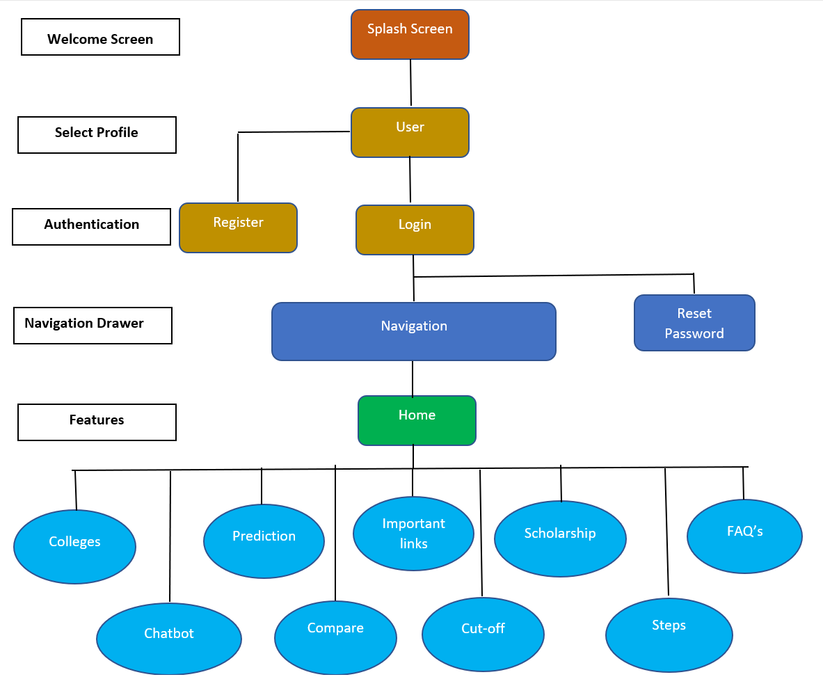
Process Design

Slide 7
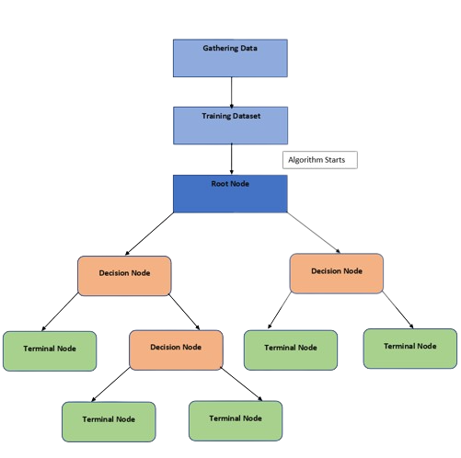
Flow Chart - Prediction

Slide 8
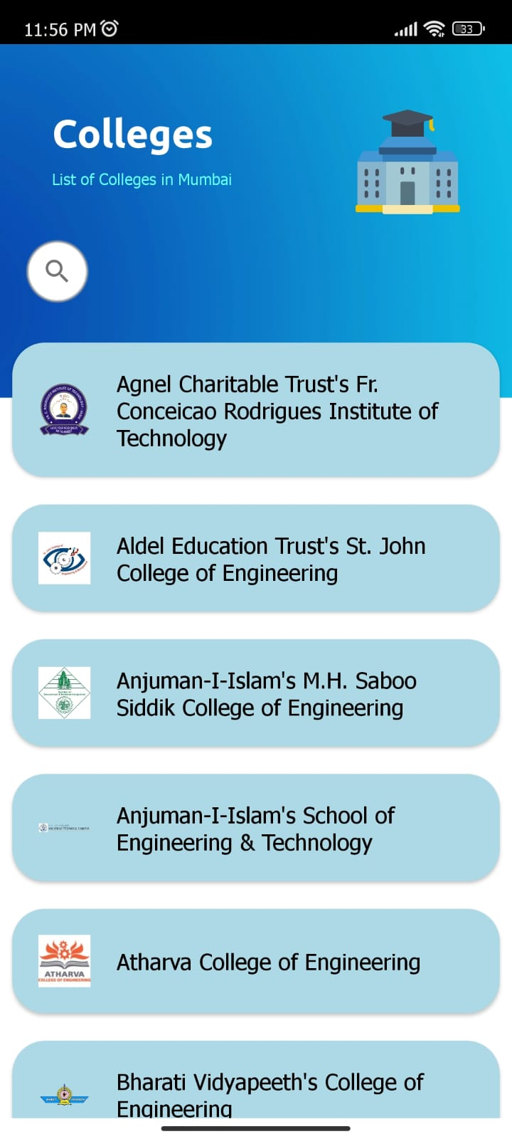
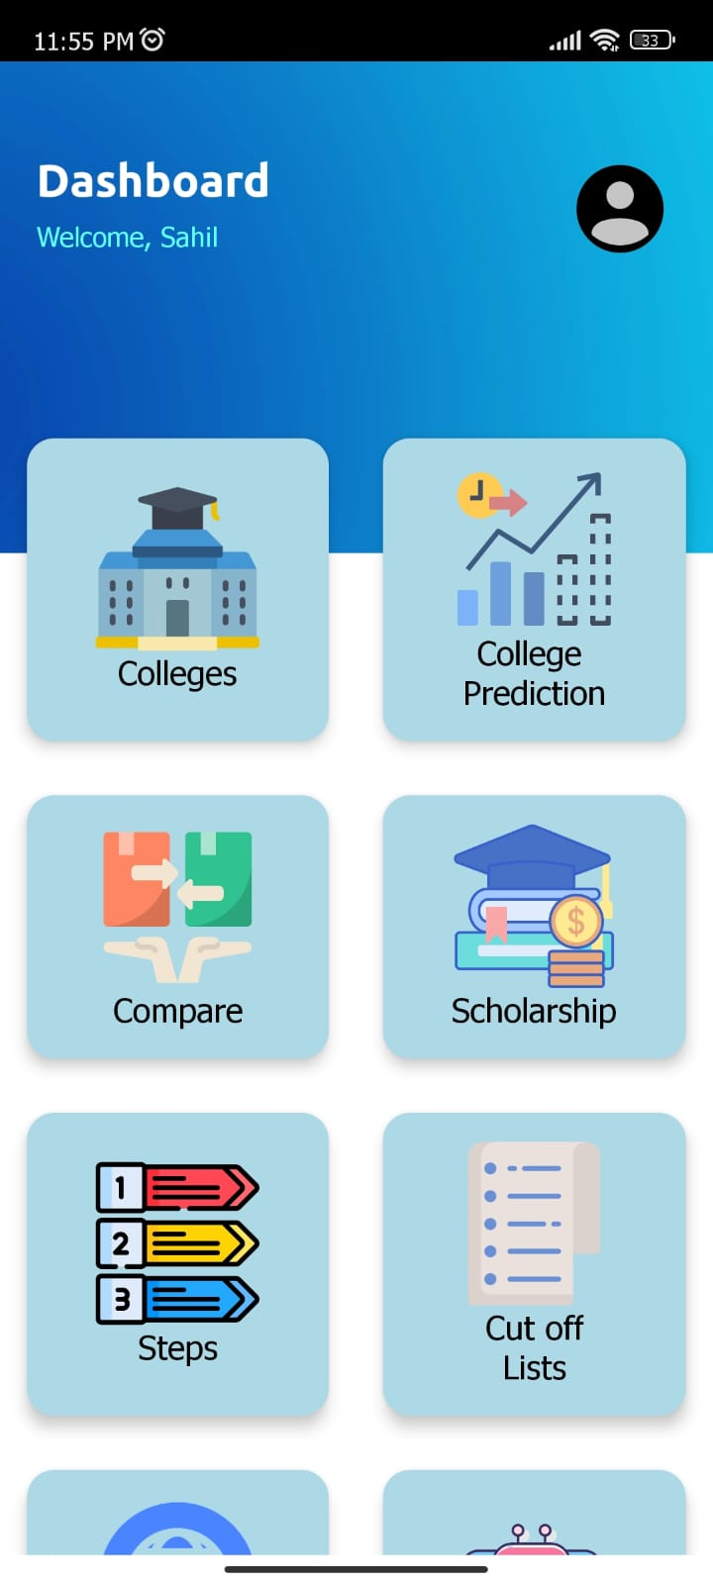
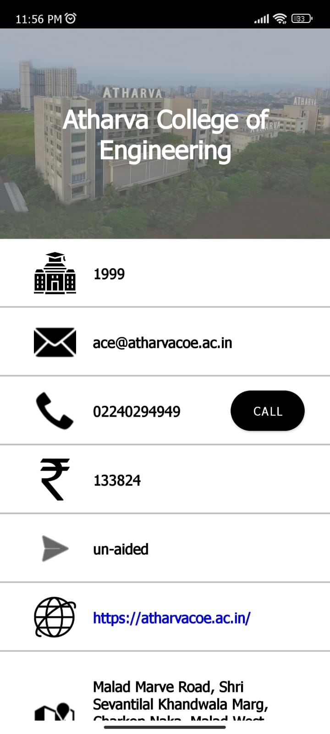
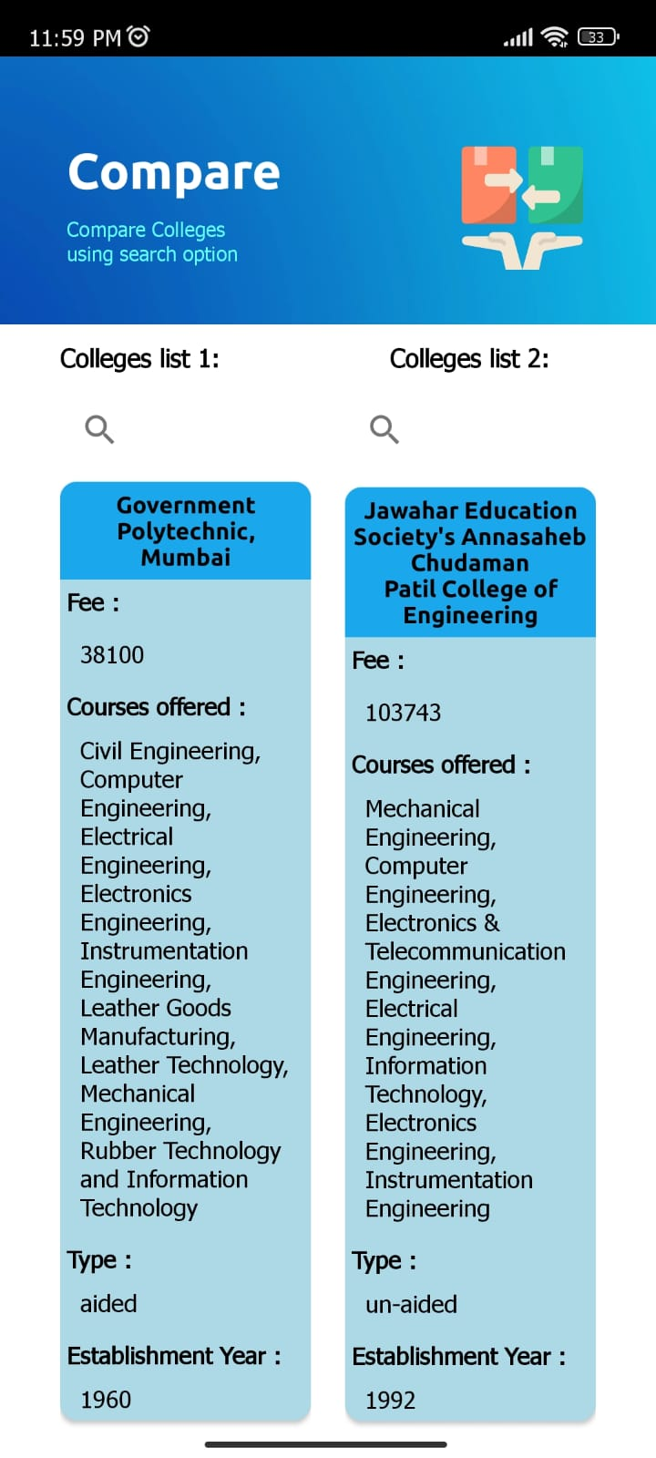
Application Screenshots

Slide 9
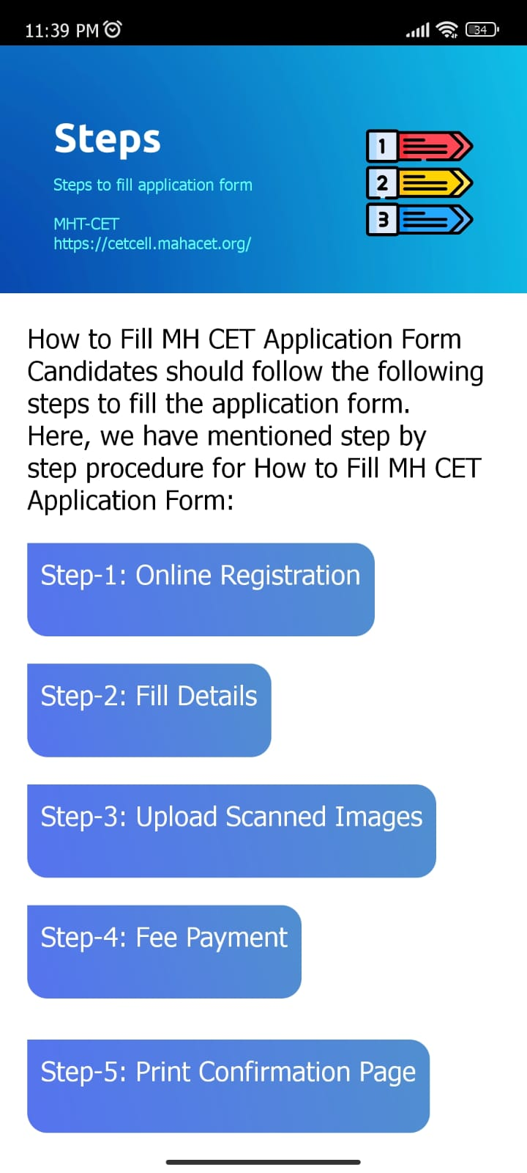
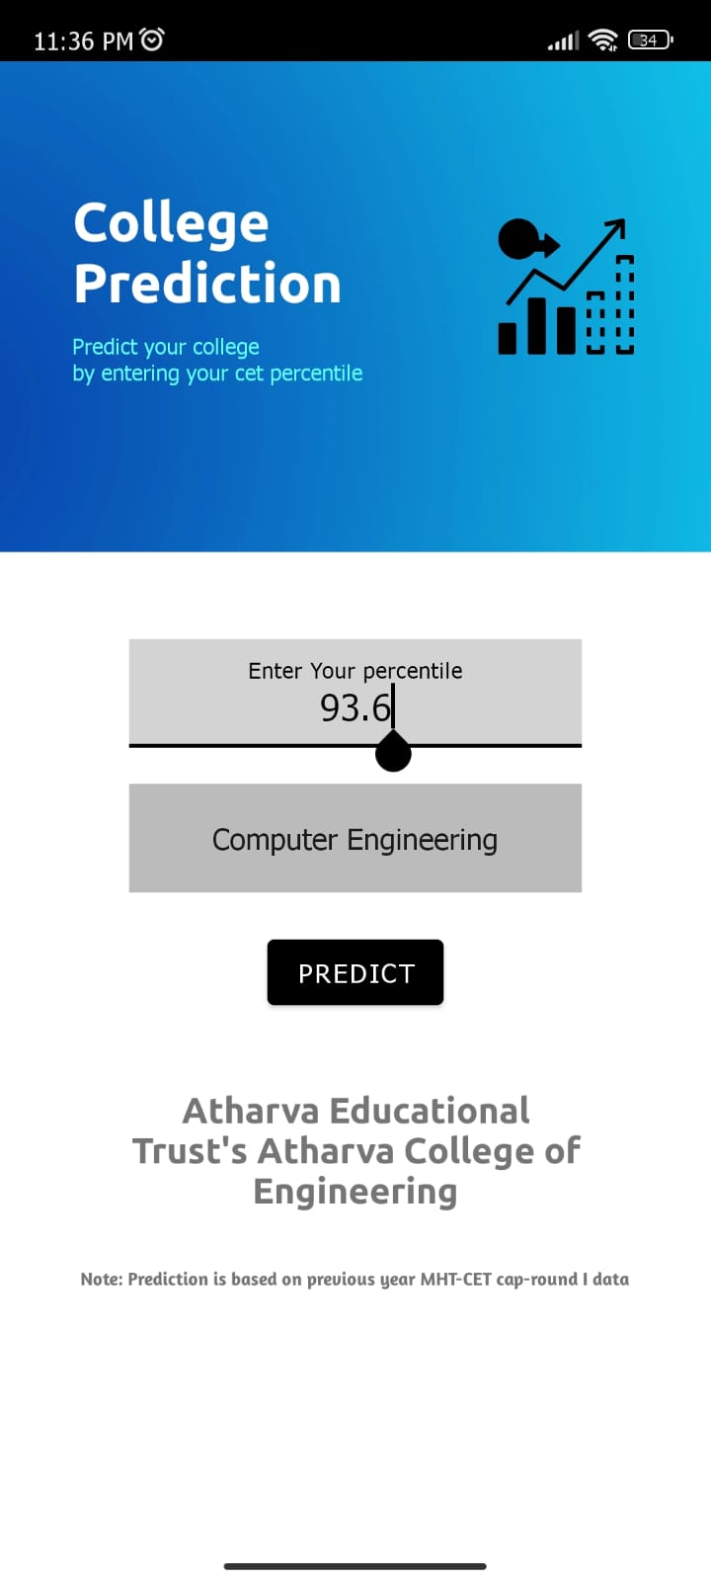
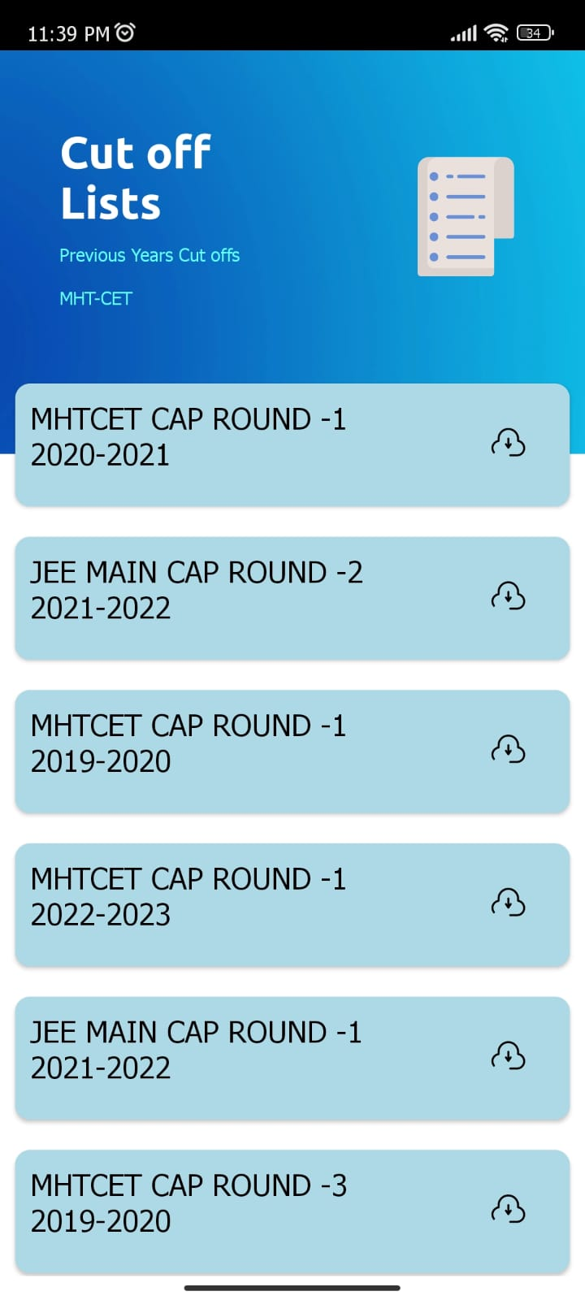
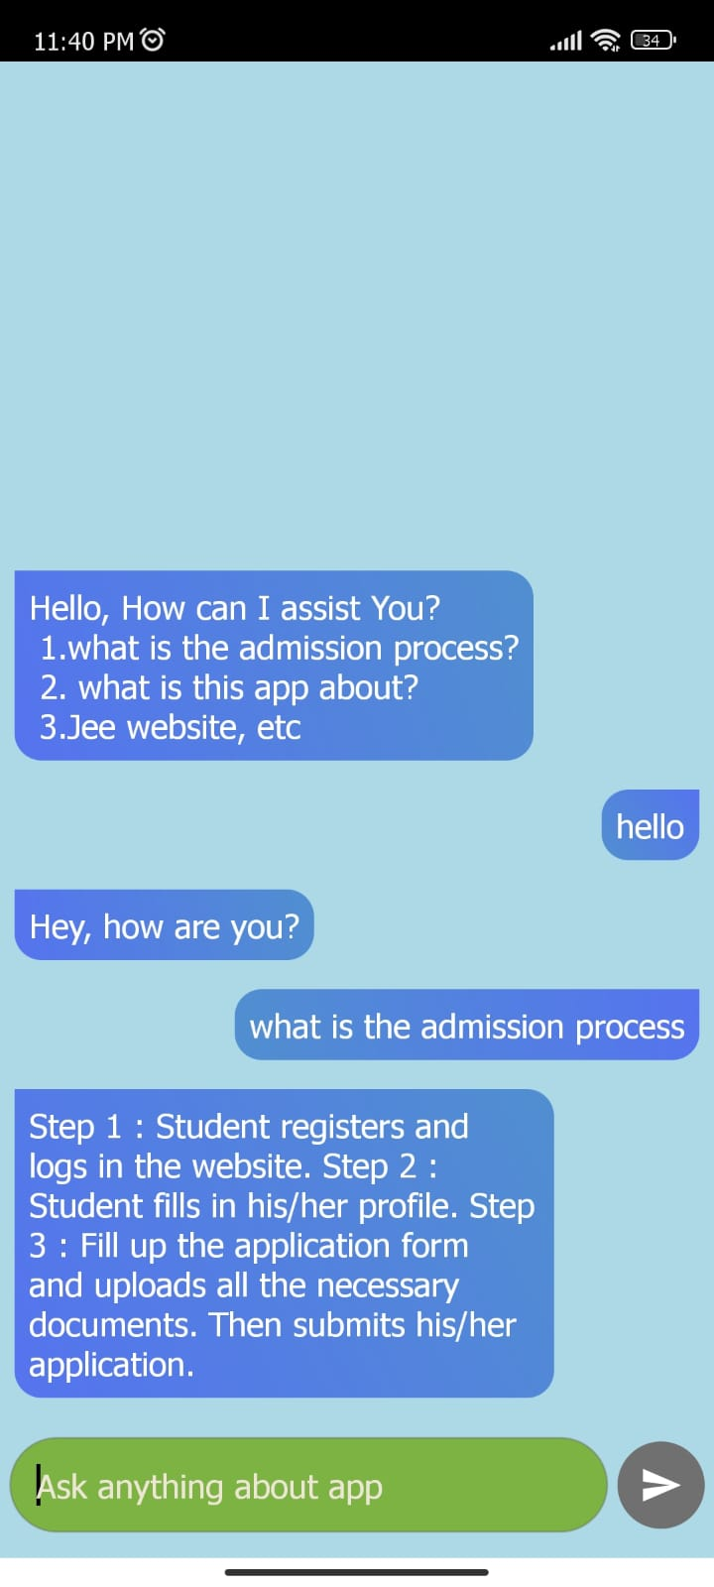
Application Screenshots

Slide 10
Feasibility
Our Android app is highly feasible and accessible to a broad user base.
The app can be easily accessed by anyone with an Android smartphone.
The app is free to use, making it accessible to all users.
The app has been designed to be user-friendly and easy to use and navigate.
Technical considerations such as compatibility, security, and performance have been taken into account to ensure optimal user experience.

Slide 11
Review of literature
SR.NO | TITLE | AUTHORS | DESCRIPTION
1) | Real Time Database for Application | Sonam Khedkar, Swapnil Thube | We became familiar with real-time databases and their capabilities, such as Google Firebase API, Mongo DB, and Rethink DB. For database storage and syncing into your Android, iOS, or web application, Google provides Firebase as an API.
2) | Android Application to Search for Church Location In Yogyakarta | Tugas Akhir | By reading this article we came to know that it is challenging for both local and out-of-town communities to learn about the location of the Catholic church they want to attend due to a lack of media information. The Google Maps API, Firebase, and Global Positioning System were used in the development of this Android app, which is built on location-based service technology
3) | Firebase as BaaS for College Android Application | Divya Sharma, Hiren Dand | New applications are released daily with the intention of giving their customers the greatest possible performance. Determining the best BaaS (Backend as a Service) depends on the needs of your project. Mobile backend services, like Firebase, which help developers by managing the backend of these applications, are built on a solid architecture. In this study, the Android app MCC App makes use of Firebase's features to demonstrate why it's the best mobile backend-as-a-service.

Slide 12
Review of literature
SR.NO | TITLE | AUTHORS | DESCRIPTION
4) | Online College Admission System | Dharni Negandhi, Aastha Mishra, Akshay Doshi, Sunidhi Desai, Rasika Thakare | We learned that manually processing admissions takes a considerable time and sometimes results in long queues. By bringing the admissions process online, so by using advance technology students can fill out the entrance applications and register in the system by just sitting at home
5) | Mobile apps for college admission: A study of students' perception in India | Kesharwani, A., & Raturi, | This study examines the perceptions of college students in India regarding mobile apps for college admission. The research found that mobile apps can be an effective tool for providing admission guidance to students, and can improve the accessibility and convenience of the admission process.
6) | Mobile applications for college admission information: A study of users' perspectives | Alsaad, A., Al-Mahrooqi, R., & Al-Abri, M. | A study conducted to examine the users' perspectives of mobile applications for college admission information. The study found that students prefer using mobile apps for admission guidance over traditional sources. The authors identified the features that users expect from a mobile app, including information on admission requirements, deadlines, and application procedures. The study suggests that mobile applications can be an effective tool for providing admission guidance to college students.

Slide 13
Review of literature
SR.NO | TITLE | AUTHORS | DESCRIPTION
7) | Decision Tree Classifier | Philip H Swain Hans Hauska | The basic concepts of a multistage classification strategy, known as the decision tree classifier, are presented in this paper. It discusses two methods for designing decision trees and reports experimental results. The paper considers the relative advantages and disadvantages of each design method and notes a spectrum of typical applications in remote sensing.
8) | Decision Tree Algorithm for Classification of data. | Zhaolong Gao; Mengvi P. Gatpandan; Paulino H. Gatpandan | It was proposed to analyze the candidate data using the decision tree algorithm in machine learning and propose an algorithm for predicting candidates to apply for a major. The prediction accuracy of the algorithm was tested by using the admission data of a certain university in Yantai as an experiment. Two complete decision trees were constructed to provide intelligent decisions and suggestions for a series of basic issues such as college selection, major selection, and voluntary reporting for high school seniors.
9) | Implementation of a Web-based Chatbot Assisted Services for Results Information System | Nwokonkwo O. C1 , , John-Otumu A. M2 , and Onuoha, M. C3 | A response to the challenges that students had with the existing result information system for retrieval led to the creation of an interactive chatbot enabled service. The proposed system utilized a natural language processing model, as well as CSS and Tailwind for graphical design and HTML for page alignment. The flask framework was employed to make web-based chatbot development easier. The results showed the effectiveness of the system.

Slide 14
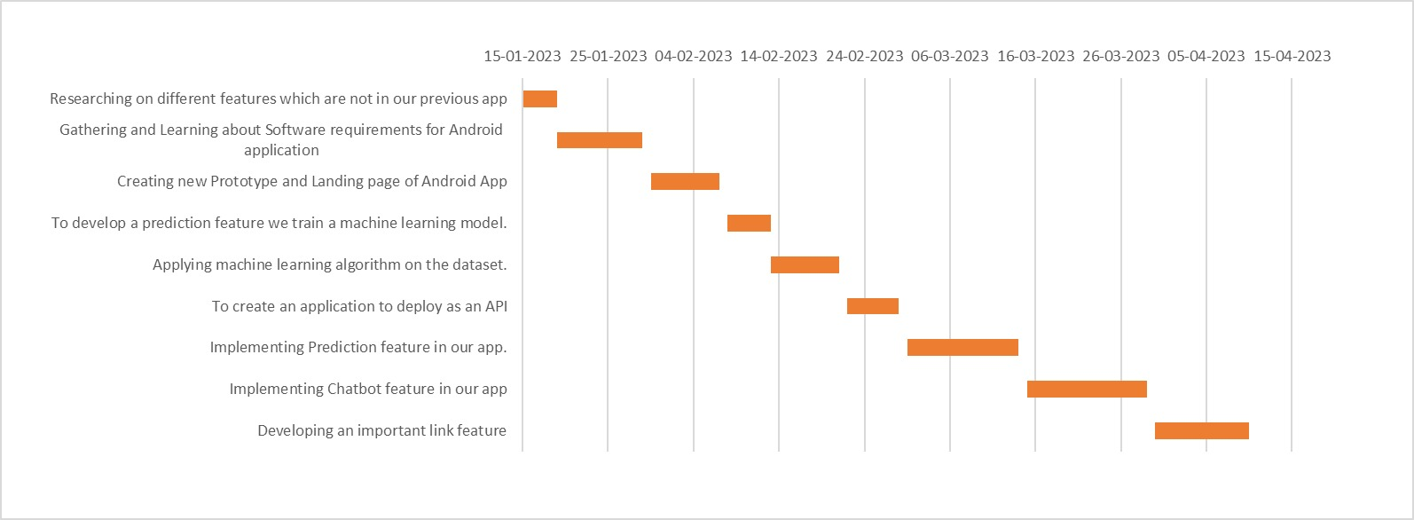
Project Schedule

Slide 15
References
Swapnil Thube, Sonam Khedkar, “Real Time Database for Application”, International Research Journal of Engineering and Technology, 06-June-2017
Tugas Akhir, “Android Application to Search for Church Location In Yogyakarta”, uajy ejournal-23319, 2020
Divya Sharma, Hiren Dand, “Firebase as BaaS for College Android Application”International Journal of Computer Applications, 20-June-2019
Alsaad, A., Al-Mahrooqi, R., & Al-Abri, M. Mobile applications for college admission information: A study of users' perspectives. International Journal of Information and Education Technology, 7(2), 120-126, 2017.
Kesharwani, A., & Raturi, A. Mobile apps for college admission: A study of students' perception in India. Education and Information Technologies, 26(2), 1217-1235, 2021
Chunnu Khawas, Pritam Shah, ”Application of Firebase in Android App Development-A Study”, International Journal of Computer Applications, June 2018
P. H. Swain and H. Hauska, "The decision tree classifier: Design and potential," in IEEE Transactions on Geoscience Electronics, vol. 15, no. 3, pp. 142-147, July 1977

Slide 16
Thank You

